Slide 1

Create an AI Agent To Capture The Flag
By : Team Tokyo

Slide 2

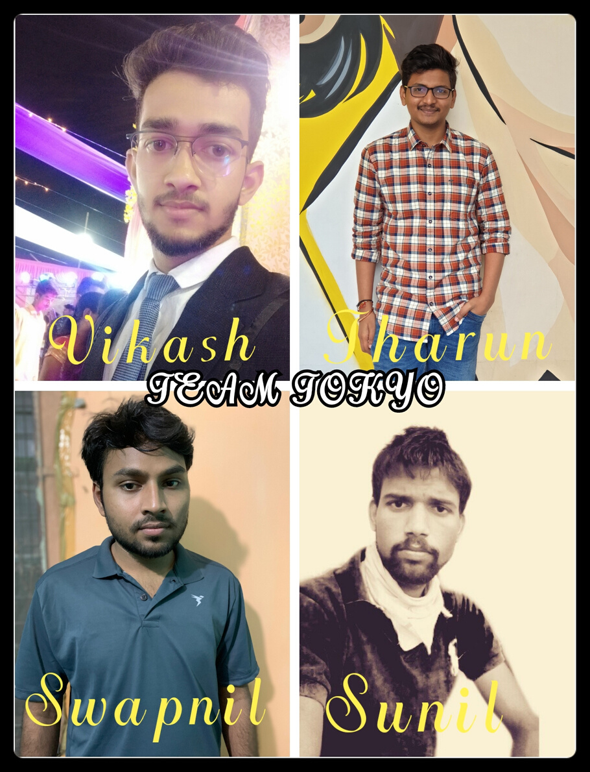
Group Members

Slide 3

Time Distributon
Understand the Multiagent Search project
Done Offensive and Defensive agent
Start
28 May 2020
30 May 2020
3 June 2020
7 June 2020
10 June 2020
14 June 2020
Understand the pacman game rule by playing it
Understand the Tracking project
Improve Strategy to win the game

Slide 4
Pacman Team
Two types of Agents
1. Defensive agent :
The ghost will always be chasing Pac-Man using the maze distance. This allows both ghosts to chase Pac-man but not always through the same path. We know that if Pac-Man is moving, this ghost will never reach Pac-Man, but this chasing behavior will rush the player to make important movement decisions and thus mistakes.
2. Offensive agent :
This agent tends to rush to the other team's half, staying as Pac-Man most of the time. The agent developed for Pac-Man was very acceptable. It started with a very basic agent that was greedily eating the closest pills and if a ghost was ahead then it will change to opposite direction

Slide 5
Defensive Agent
1.
First it will try minimise the distance between opposition pacman if any and catch them.
2.
If he find that oppositions pacman has eaten capsule then it will try to minimize the distance between opposition pacman if distance greater one else it will try to maximize the distance between them
3.
If he find that there is no pacman in opposition team then it try to catch opposition food. if count of food is greater than equal to three then it will return to its original position i.e. fisrst will come to his team and then try attack if their is no pacman in opposition team
4.
If he go to attack and find their is pacman in opposition team then it will try minimise the distances between pacman and catch them.
5.
While attacking if he find that opposition player is scared then this case ,it will not fear the opposition player and if possible ,it will eat them.

Slide 6
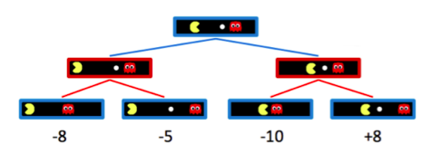
Minmax
∀ agent-controlled states, V(s) = max V(s') for s'∈successors(s)
∀ opponent-controlled states, V(s) = min V(s') for s'∈successors(s)
∀ terminal states, V(s) = known

Slide 7
Offensive agent
1.
First of all ,when the agent is not pacman it will try to catch all the opposition pacman in range of distance within 10.
2.
At the sametime ,it will try to minimise the distance beteen opposition team food or capsule without caught by opposition pacman.
3.
If the count of food is four then it will try return to its team provided their is no food in its surrounding
4.
If their is food in its surrounding ,then it will eat. if count of food gets greater than equal to six then it will return to its team and try again.
5.
If he find food and capsule at distance one from him ,then it will eat capsule.
6.
If he find opposition player is scared then our pacman will try eat them if possible.

Slide 8
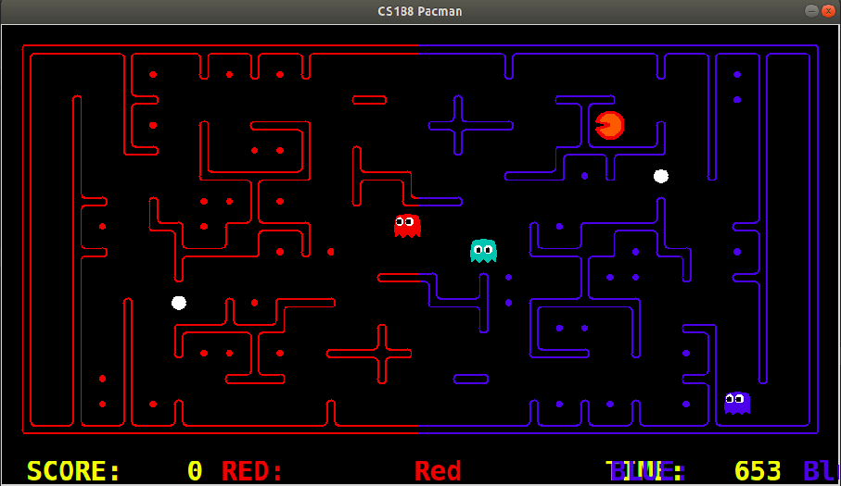
In this picture the red pacman stuck in the vally and move front and back.

Slide 9
Review of loss
1.
As we defensive agent which has only job to to protect the food and not attack on opposition side.
2.
Sometime agent get stuck some places so it just wasted of time and we are not geeting score.
3.
Agent did not give priorities to capsule than food.

Slide 10
Review of Win
1.
Our attacking agent will return after having count of food greater than equal to four.
2.
As the defensive agent patrolling on boundries it will become very to catch ooppent pacman.

Slide 11
Improvements
1.
Pacman agent will give more favor to capsule than food if both of them having same distance from pacman position.
2.
If pacman agent find opposition agent is scared in this case pacman will try to eat ghost if its comming in its food path.
3.
It will try to find another path if it stuck in some position.(i.e. if it repeat same position thrice so their is problem. in this case it will take random action)

Slide 12
Improvements
4.
Our defensive agent try to attack on opposition side if both agent on opposition side are not pacman.
5.
If the agent find food to its vicinity then it will eat through its count is four if opposition ghost is far.
6.
Agent will return as soon as food count goes greater than equal to three or opposition agent become pacman.
7.
It will try to goes away from the our teammate if opposition palyer in range of distance of three to our teammate and our defensive agent.

Slide 13
Challenges Experienced
1.
During the Minmax implementation I got many problems with outOfBounds , and empty Lists.
2.
The tweaking of values for costs was tricky, and it might require a deeper analysis for optimal values. I determined the values by experimentation and tests.
3.
Easy to be eaten by the opponent when staying close to it at the border because the agent may cross the border and become pacman for one step
4.
Sometimes the scared agent will get stuck in an alley when escaping
5.
Can’t detect the invader if it’s far from the agent and out of its sight
6.
The agent always chooses to stop when patrolling
7.
Can’t detect reduction of food when someone was eaten and split its pacdots before

Slide 14
Future Improvement
1.
Pac-Man agent: Most of the times this agent gets eaten by a Ghost because it chooses a path that leads to a corridor with only one entrance and one exit, so it can get ambushed, with no optimal path. A solutions is to analyze the Maze at the beginning of the game and recognize these "dangerous" paths, and then give them a higher value, so that they can be taken only if safe situations
2.
Try some other strategies such as forcing the invader into a dead area and stop before killing him if we've got more scores
3.
Use the Monte-Carlo tree search to simulate several steps when escaping to avoid the dead areas
4.
A better heuristic function can be designed to expand fewer nodes in Minmax algorithm.

Slide 15
Performence
Approaches
Performance
1.
Good
“Corner Food” feature
2.
“Path Planning”
Excellent
3.
“Eat Ghost” feature
Adequate
4.
Time & Score Trade Off
Excellent
5.
Stick to the opponent on the border
Good
6.
Keep following the the invader when I'm scared until the dist is 1
Excellent
7.
Locate the position where the pacdots disapearred
Excellent

Slide 16
Discussion
My Pac-man agent has as main objective eating all the pills. It accomplishes this objective by using Minmax to find the safest path (no ghosts intersections).
My team agents have two main behaviors: chasing and cornering. One ghosts are in charge of chasing Pac-Man using Path and Manhattan Distance. The other two ghosts go to the two closest future intersection of Pac-Man according to Pac-Man's current direction. Unfortunately this team did not show a dramatic improvement when playing against my Pac-Man agent, but playing by myself I can feel more pressure from the ghosts.
This project provided us with experience in Search (A*), Minimax, Markov chain and Bayes Net. And we are able to experience how A* can be used in pathfinding and also evasion. And Markov chain experianced us to finding probability of next position of invader.

Slide 17
Practical use
1.
Use virtual assistant programs to provide real-time support to users
2.
Effectively track user behaviour and automate many routine marketing tasks.
3.
AI can help you interpret and mine your data more efficiently than ever before and provide meaningful insight into your assets, your brand, staff or customers
4.
Use AI applications to determine when you might reach performance goals, such as response time to help desk calls.

